Slide 1
SECOND YEAR PROJECT
Laboratory Information System (LIS)
for Medical Laboratories with Semi-Automatic Equipment
Digital Transformation in Healthcare
Institution
Supervisor
General Sir John Kotelawala Defence University
Faculty of Computing
Dr. BVKI Vidanage
Group Members
AAN Hirundika • WMDGJ Warnasooriya • Kavindu Kavishka • PV Kavinda • P Rohit • Imesha Rajapaksha

Slide 2
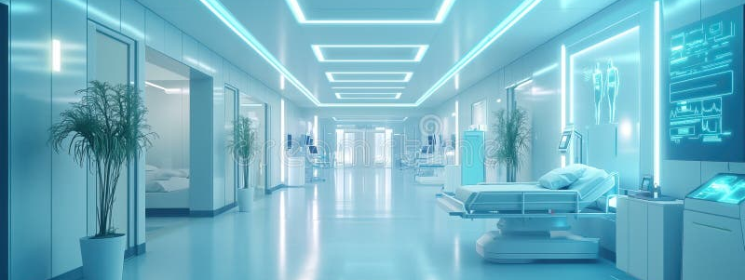
Project Context
Introduction
Critical Healthcare Infrastructure
Project Motivation
Medical laboratories serve as the backbone of healthcare delivery, providing essential diagnostic services that guide treatment decisions and patient care pathways.
Streamline workflows to eliminate bottlenecks and accelerate diagnostic processes
Reduce errors through automated data entry and validation mechanisms
Outdated Systems
Improve patient experience with faster turnaround times and digital accessibility
Many laboratories continue to rely on manual processes, paper-based documentation, and Excel spreadsheets for managing patient data and test results.
Systemic Inefficiencies
These legacy approaches create significant operational delays, increase error rates, and ultimately result in poor patient satisfaction and compromised care quality.

Slide 3
Current Challenges
Problem in Brief
Appointment Scheduling
Excel-Based Reporting
Manual phone-based booking and paper appointment logs create scheduling conflicts and long patient wait times.
Report generation takes 15-20 minutes per patient using Excel templates, severely limiting laboratory throughput.
Time per Report
15-20 min
Patient Registration
Handwritten registration forms lead to data entry errors, illegible information, and duplicate patient records.
Critical Gaps
No centralized database
Result Transcription
No audit trail system
Manual data entry from semi-automatic equipment introduces transcription errors and delays result availability.
No online patient access
Limited scalability

Slide 4
Existing Systems Analysis
Literature Review
Comparative analysis of laboratory information systems in Sri Lankan healthcare institutions
Laboratory | System Type | Key Challenges
Nawaloka | Partially automated LIS | High complexity, high cost
Durdans | Custom LIS | Excel slows down with 200+ patients/day
Asiri | Hospital-integrated LIS | Most suitable for automatic machines
Independent Labs | Excel + Paper | High error rates, no patient portal
Key Insight: All analyzed systems struggle with Excel limitations, lack of integration, and absence of patient-facing digital services—gaps our LIS aims to address.

Slide 5
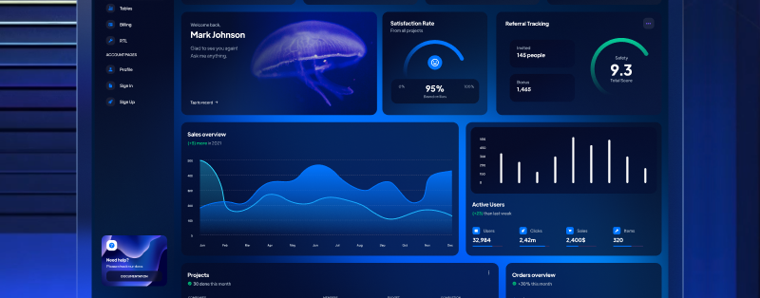
Innovation
Novelty & Innovation
Tailored for Semi-Automatic Equipment
Modern React.js Frontend
Built-in Audit Trails
Unlike generic LIS solutions, our system is specifically designed to seamlessly integrate with semi-automatic laboratory equipment workflows.
Built with React.js for a responsive, modern user interface that delivers exceptional user experience across all devices.
Comprehensive logging system ensures regulatory compliance and data integrity with complete traceability of all system actions.
Optimized data entry interfaces
Component-based architecture
Complete action history
User activity tracking
Cost-Effective Solution
Integrated Notifications
Compliance ready
Leverages open-source technology stack to deliver enterprise-grade functionality at a fraction of commercial LIS costs.
Built-in SMS and email notification system keeps patients informed when the report is ready.
<35,000 LKR
Total development cost
dashboard interface

Slide 6
Project Goals
Aim & Objectives
Primary Aim
Develop an integrated Laboratory Information System that replaces Excel-based workflows with a comprehensive digital solution for medical laboratories using semi-automatic equipment.
1
2
3
Centralize Patient Data
Automate Report Generation
Enable Online Booking
Implement PostgreSQL database for unified patient information management
Use React-PDF for instant professional report creation and distribution
Provide web-based appointment scheduling for patients and staff
4
5
6
Real-time Notifications
Ensure Compliance
40-Week Timeline
Implement SMS/email alerts for appointment and result updates
Build comprehensive audit trails for regulatory requirements
Complete development within allocated academic project timeframe

Slide 7
Development Approach
Proposed Methodology
Three-Tier Architecture
Complete Workflow Process
Frontend
1. Registration
React.js + Tailwind CSS
Patient data entry and account creation with validation
Responsive, modern UI
2. Billing
Backend
Automated invoice generation and payment tracking
Node.js
Scalable server-side
3. Sample Tracking
Database
PostgreSQL
Reliable data storage
4. Result Entry
Manual input from semi-automatic equipment with validation
Agile Methodology
5. Report Generation
2-week sprints for iterative development with continuous feedback and adaptation.
Automated PDF creation with React-PDF library
Flexible & adaptive
6. Notification
SMS/email alerts to patients and referring physicians

Slide 8
System Capabilities
Functional Requirements
Core features that define the system's operational capabilities
Online Appointment Booking
Automated Report Generation
Web-based scheduling system allowing patients to book, reschedule, and cancel appointments without phone calls.
Instant PDF report creation using React-PDF with professional formatting, lab headers, and digital signatures.
24/7 Access
Real-time Availability
<5 Seconds
Professional Format
Manual Result Entry Interface
SMS/Email Notifications
Intuitive data entry forms designed specifically for technicians to input results from semi-automatic equipment efficiently.
Automated multi-channel notification system for appointment reminders, status updates, and result availability alerts.
Validation
Quick Entry
SMS Gateway
Email Integration
Role-Based Access Control
Comprehensive permission system with distinct roles for administrators, technicians, receptionists, and patients ensuring data security and appropriate access levels.
Admin
Technician
Reception
Patient

Slide 9
Quality Attributes
Non-Functional Requirements
Security
Performance
Responsiveness
TLS 1.3
Load Time
<3s
Desktop
Latest encryption protocol
Maximum page load time
Full feature access
JWT Authentication
10+
Tablet
Secure token-based auth
Concurrent Users
Touch-optimized UI
Simultaneous access support
HTTPS
Mobile
Encrypted communications
Uptime
99.5%
Responsive design
System availability target
Data Management
Compatibility
PostgreSQL
ACID
Audit Trails
Centralized database
Transaction compliance
Complete logging
Chrome
Firefox
Safari
Edge

Slide 10
Technology Stack
Tools & Technologies
Modern open-source technologies powering the LIS solution
React.js
Tailwind CSS
Frontend Framework
Styling Framework
Component-based JavaScript library for building dynamic, responsive user interfaces with virtual DOM optimization.
Utility-first CSS framework enabling rapid UI development with consistent design system and responsive layouts.
Virtual DOM
Component-Based
High Performance
Utility-First
Responsive
Customizable
Node.js
PostgreSQL
Backend Runtime
Database System
JavaScript runtime environment for building scalable, event-driven server-side applications with non-blocking I/O.
Advanced open-source relational database with ACID compliance, extensibility, and robust data integrity features.
Event-Driven
Non-Blocking
Scalable
ACID
Reliable
Extensible
React-PDF
Client-Side
Customizable
PDF generation library for creating professional, customizable laboratory reports directly from React components.

Slide 11
StakeHolders
Users of the LIS and Their Roles
Administrator
Technician
Manages user accounts and role-based access control
Oversees audit trails and compliance reporting
Monitors system performance and security
Inputs test results from semi-automatic equipment using validated forms
Ensures accuracy of diagnostic data before report generation
Receptionist
Patient
Handles patient registration and appointment scheduling via the online portal
Manages billing and payment tracking
Provides frontline support for patient inquiries
Books, reschedules, or cancels appointments online
Receives SMS/email notifications for results and updates
Accesses digital laboratory reports securely anytime

Slide 12
Quality Assurance
Proposed Testing & Evaluation
Unit Testing
User Acceptance Testing
Individual component testing to ensure each module functions correctly in isolation before integration.
Real-world validation with laboratory staff to ensure the system meets operational requirements and user expectations.
Jest testing framework
Stakeholder feedback
Quality Assurance
Integration Testing
Comprehensive QA process with audit trail verification to ensure data integrity and regulatory compliance.
Verify seamless interaction between frontend, backend, and database components as a unified system.
Audit trail validation
API endpoint validation
Data integrity checks
Evaluation Criteria
Accuracy
Performance
Usability
Data precision and error-free operations
Response times and system throughput
User satisfaction and ease of use

Slide 13
Project Timeline
Time Plan
Total Project Duration
40
Complete development lifecycle from requirements to deployment
Weeks
1
2
3
4
Analysis
Design
Development
Testing & Deploy
10
12
18
10
Weeks
Weeks
Weeks
Weeks
Requirements gathering
UI/UX design
Frontend development
Unit & integration testing
Stakeholder interviews
Database schema
Backend API
UAT & bug fixes
System analysis
Architecture design
Database setup
Deployment
Feasibility study
Prototype development
Integration
Documentation
MS Project
Trello
Jira
Project management tools for tracking progress and collaboration

Slide 14
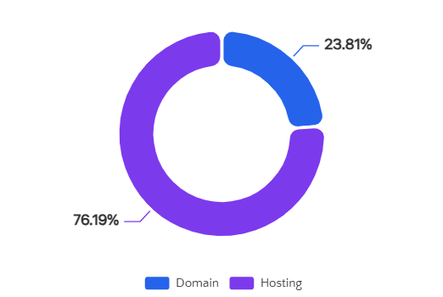
Cost Analysis
Budget
Cost-effective solution with minimal infrastructure investment
Cost Breakdown
Cost Distribution
Domain (.com)
2,500 LKR
Annual registration
Hosting
8,000 LKR
Cloud server (annual)
Total Project Cost
10,500 LKR
Value Proposition
Open-Source Advantage
Affordable for small-medium labs
Zero licensing fees for React.js, Node.js, and PostgreSQL significantly reduce total cost of ownership
No recurring license costs
Scalable infrastructure

Slide 15
Project Summary
Conclusion
System Transformation
Automation Benefits
The proposed LIS will replace fragmented Excel and paper-based systems with a unified digital platform, eliminating manual inefficiencies and data silos.
Centralized data management and automated workflows will dramatically reduce report generation time from 15-20 minutes to under 5 seconds per patient.
Cost-Effective
Improved Efficiency
Patient Satisfaction
Open-source technology stack delivers enterprise functionality at minimal cost.
Faster workflows
Online booking
Reduced errors
Faster results
<35,000 LKR
Better resource use
Digital access
Total investment
Scalable Solution
Designed for small to medium laboratories, providing an affordable pathway to digital transformation while maintaining flexibility for future growth and feature expansion.
Scalable
Extensible

Slide 16
References
1
World Health Organization, Laboratory Quality Management System Handbook, WHO Press, 2011 .
2
Centers for Disease Control and Prevention, "Laboratory Informatics Overview," CDC, Atlanta, GA, USA, 2018.
P. G.-D. e. al, "The World Health Organization African Region Laboratory Accreditation Process," American Journal of Clinical Pathology, vol. 134, p. 393–400, 2010.
3
4
R. L. Wagar, B. Yuan and M. B. Bickel, "Impact of Laboratory Information Systems on Clinical Laboratories," Clinical Leadership & Management Review, vol. 20, 2006.
Thank You
Questions & Discussion

